Slide 1
Image Classification Photos vs Comics
Vladimir Kozitsky

Slide 2
Outline
Problem Description
Data Collection and Examples
Prior Work
Additional Features and Descriptors
Choice of Classifier
Results
Summary

Slide 3
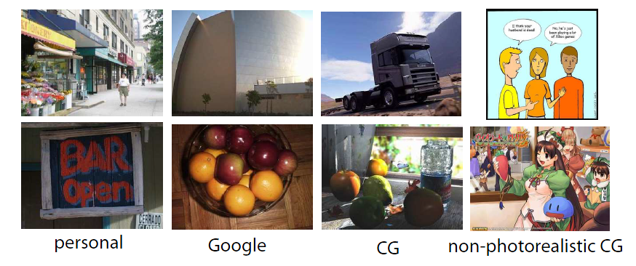
Project Description
Many different types of images exist.
Separating genuine photographs from high end computer graphics is difficult even for humans.
Google “fake or photo”
Focus on real photographs vs comics and animation

Slide 4
Data Collection
Image sets quoted in published papers are out of date or no longer exist. Create custom set – time consuming.
Real photographs from travel gallery of Phillip Greenspun
Professional photographer. Founder of Photo.net
Custom web crawler to deal with relative links
Comics from GoComics.com and Dilbert.com
Animated Movie Frames from DisneyScreenCaps.com

Slide 5
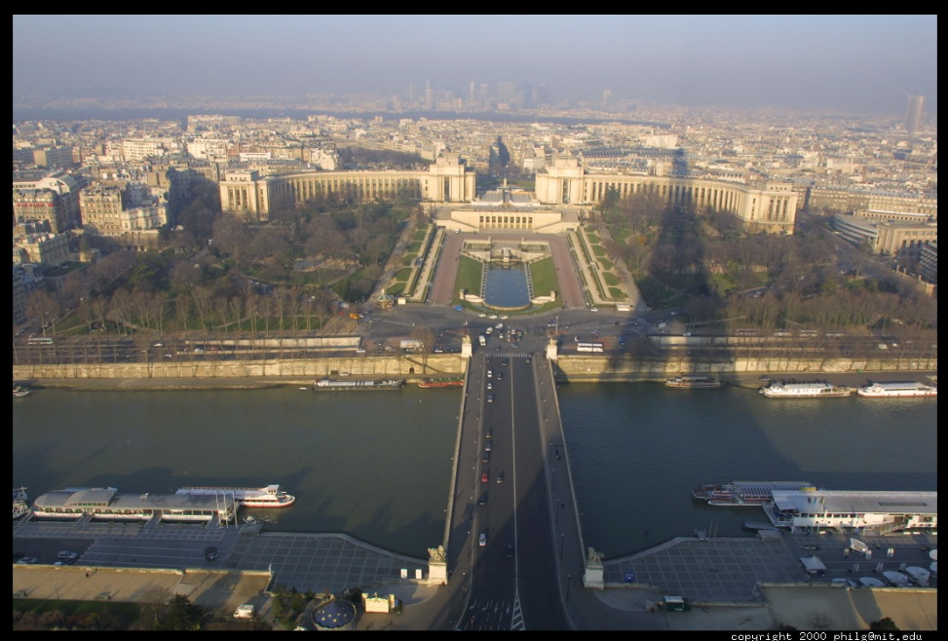
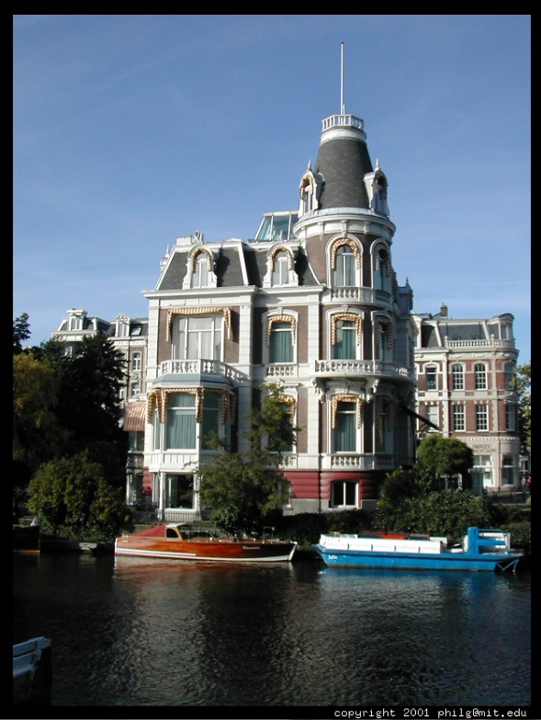
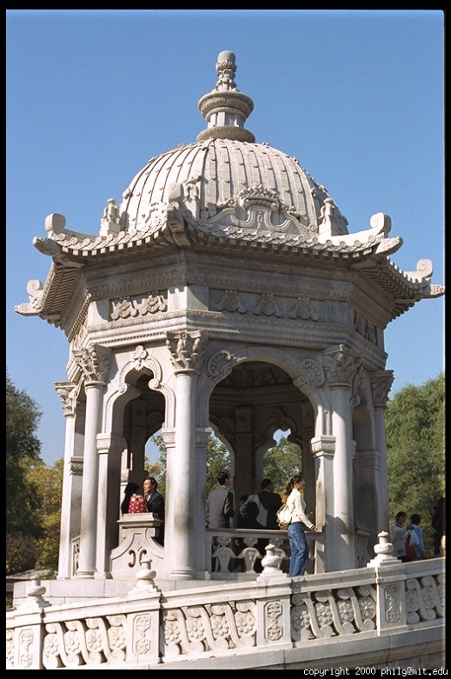
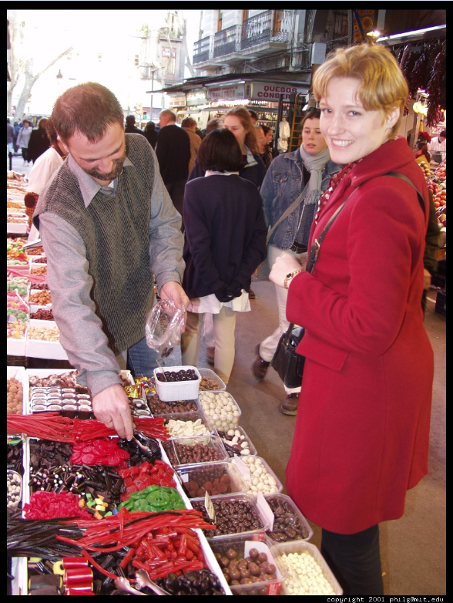
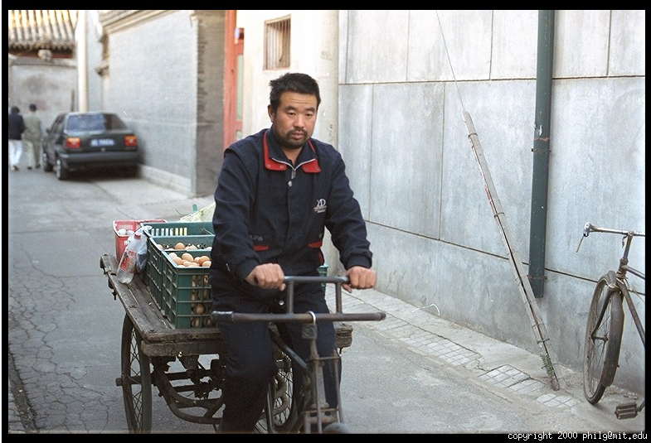
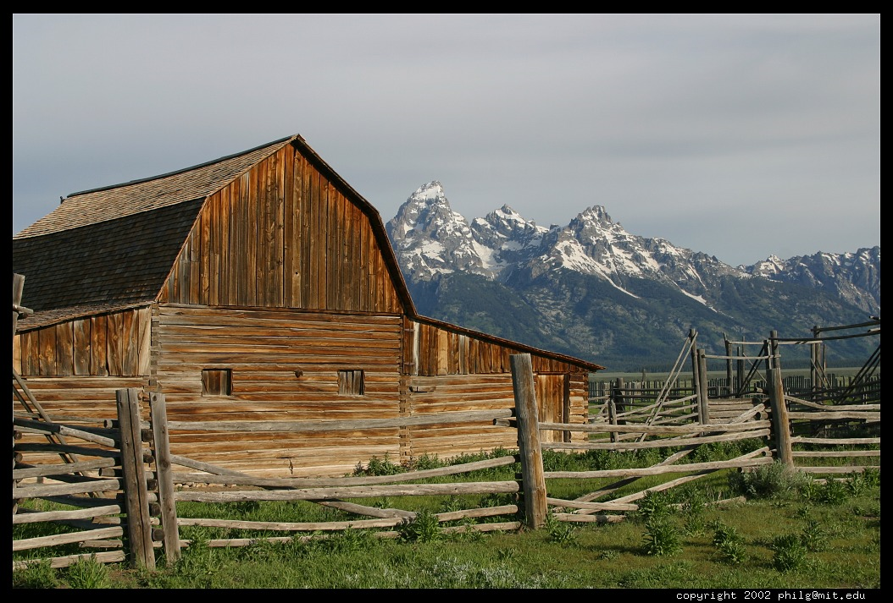
Image Examples - Photos

Slide 6
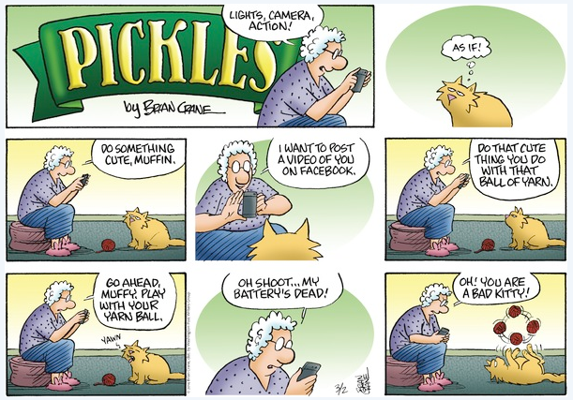

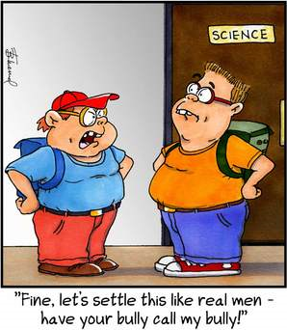

Image Examples - Comics

Slide 7
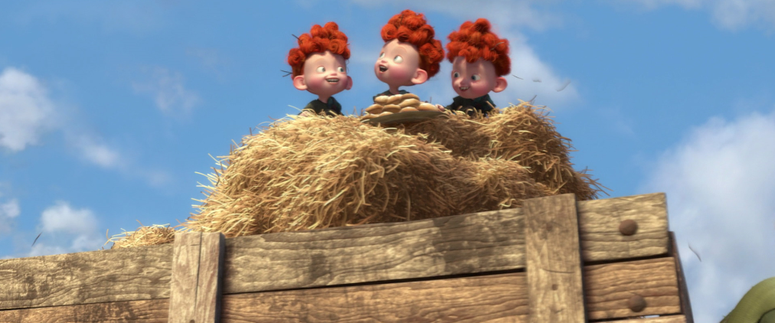
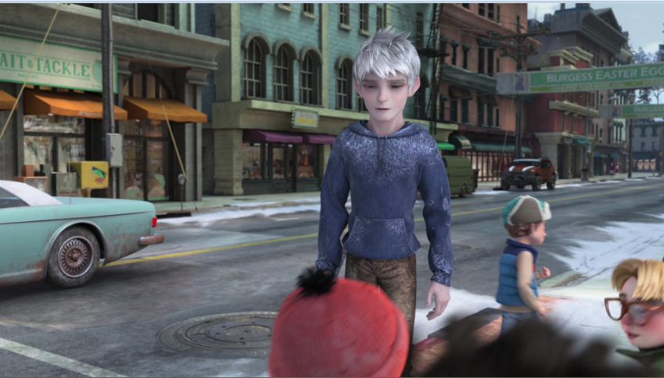
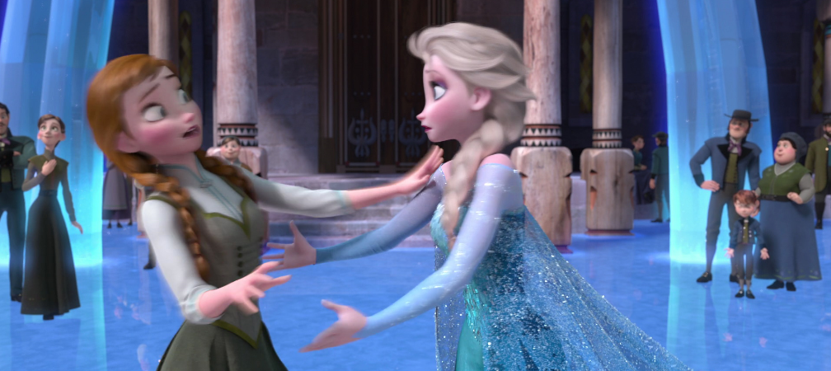
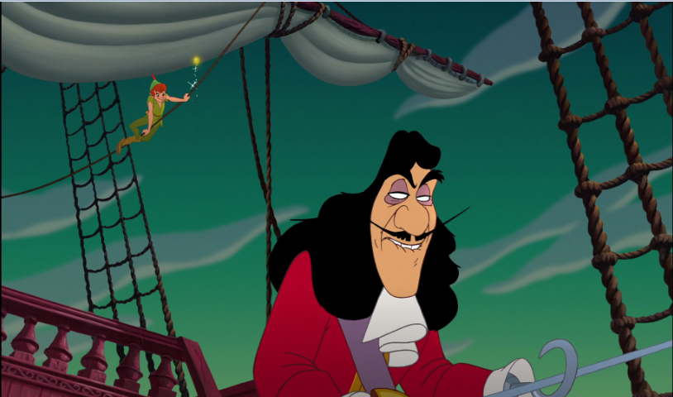
Image Examples - Movies

Slide 8
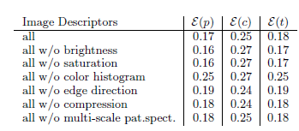
Prior Work on This Problem
Color Features – HSV
Brightness: Cartoons have light backgrounds so take ratio of V channel values above a threshold and normalize.
Saturation: Abstracting real world leads to exaggeration in saturation. Take mean of S channel as indicator.
Color Histogram: Few simple strong colors should represent animations capture this using 3x3x5 (HxSxV) histogram.
Edge Histogram
Cartoons tend to have strong dark edges. Capture both magnitude and angle of edges using 5x8 (MxA) histogram.
Compression Ratio
Cartoons are simple thus they should compress more. Reduce images to top 255 colors and save as lossless PNG. Compare size.
Data set was movie frames.
Color Histograms - Most important.

Slide 9
Additional Features
Blur – Cartoons should be less blurry given sharp edges.
Face Detector (Viola Jones) – OpenCV Haar Cascade trained on real human faces (frontal and profile) shouldn’t find faces in cartoons.
GIST – Measure perceptual dimensions of a spatial envelope
Naturalness: Low for scenes with vertical and horizontal lines – man made
Openness: High for scenes with horizon line and low visual references
Roughness: Size of elements across spatial scales. High for detailed texture.
Expansion: High for converging parallel lines.
Ruggedness: Low or flat urban high for mountainous landscapes. G/H deviation
Spatial Pyramid Features – Combination of weak (edge orientation) and strong SIFT descriptors across 3 level pyramid. Works well for scene categorization. Many features, 10X any other evaluated.

Slide 10
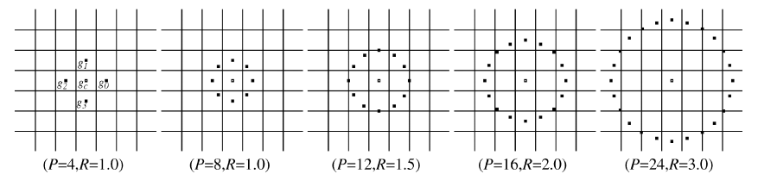
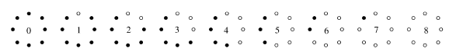
Additional Feature
LBP – Local binary patterns. (Gray images)
A binary pattern is calculated for each pixel given parameters R, and P
Binary: Sign of sample gray level difference from center pixel (2^P descriptors)
Normalized histogram of patterns returned as feature vector.
Provides gray scale invariance to scale and gain. High texture sensitivity.
Rotation Invariance
Set of 2^P patterns is reduced to eliminate rotation redundancy.
VAR - Local Variance Measure
Captures contrast of local texture to complement LBP
Instead of difference of sample from center, use difference from local mean.

Slide 11
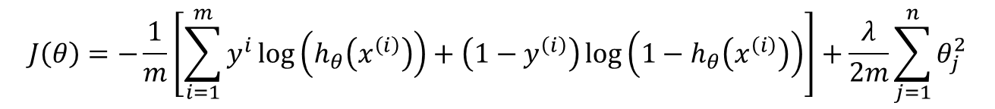

Choice of Classifier
Most papers use SVM’s with various kernel functions
Require tuning, complicates comparisons and lacks interpretability
Regularized Logistic Regression Chosen
Straightforward Implementation
Sigmoid function returns class probability directly
Requires Cost Function (Gradient for speed-up)
Using Matlab’s fminunc() solver with cost function and gradient input
Solvers: fminunc() better results then fmincon()
mnrval() sporadic matrix errors, glmfit() poor performance
$$P\left(y=1 | x;θ\right)=\frac{1}{1+e^{−θ^{T}x}}$$
$$J\left(θ\right)=−\frac{1}{m}\left[\sum_{i=1}^{m}{y^{i}\log\left(h_{θ}\left(x^{\left(i\right)}\right)\right)+\left(1−y^{\left(i\right)}\right)\log\left(1−h_{θ}\left(x^{\left(i\right)}\right)\right)}\right]+\frac{λ}{2m}\sum_{j=1}^{n}{θ_{j}^{2}}$$

Slide 12
Testing Methodology
Positive Class: 4349 Photographs
Negative Class: 3582 Comics (1527) and Movie Frames (2055)
Sample [25, 100, 300, 500] examples from each class.
Train LR using samples and test on the rest. Reg Val = 0.01
Repeat 10 times and take average TPR/FPR
Use area under the ROC curve as measure of performance.
~

Slide 13
Results Summary
Area Under FPR/TPR Curve
.94 v .96

Slide 14
Results FP

Slide 15
Results FN

Slide 16
Summary
Rotationally Invariant Uniform LBP features combined with VAR returned the best performance overall.
Highest accuracy for same number of training examples
Equal accuracy with less training examples (100 vs 500)
Better generalization – less features (26 vs 88)
Edge information better indicator then color(s)
Strictly vertical lines are strong indicator of non-photos
Photos hardly ever have perfect vertical lines
Horizon, vanishing points, vignetting, …
? Questions ?

